Slide 1
Data Engineering Fundamentals
Sources, Formats, Models and Data Processing
Student: Paulo Eduardo da Silva Junior

Slide 2
Summary
Data Sources;
Data Formats;
Data Models;
Storage and Processing Engines;
Data Flow Modes;
Batch Processing vs. Stream Processing;
Conclusion.

Slide 3
Data Sources
User input: text, images.
System-generated data: logs.
Internal databases.
Third-party data.

Slide 4
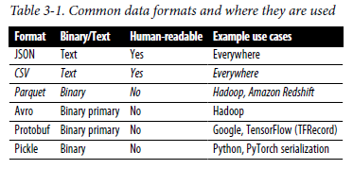
Data Formats
JSON: Structured and unstructured, human readable.
Row-Major (CSV): Fast row access.
Column-Major (Parquet): Fast column access, binary.
Text vs. Binary: Binary saves space and is faster.

Slide 5
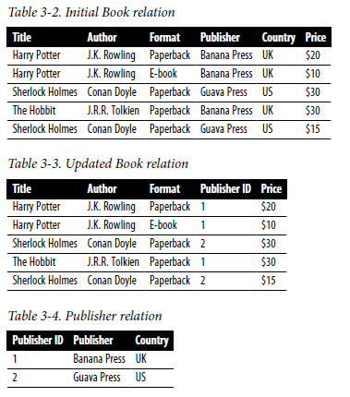
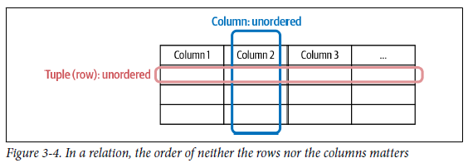
Data Models
Relational: Normalized data, complex queries.

Slide 6
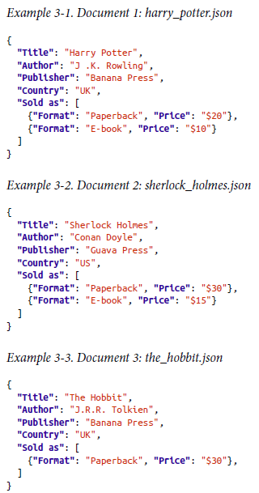
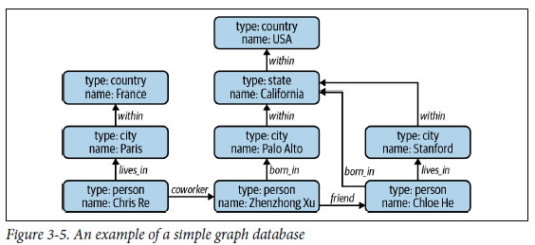
Data Models
Relational: Normalized data, complex queries.
NoSQL: Flexibility and efficiency in complex relationships.

Slide 7
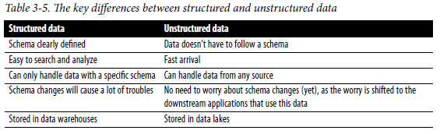
Data Models
Relational: Normalized data, complex queries.
NoSQL: Flexibility and efficiency in complex relationships.
Structured vs. Unstructured: Schema-based vs. flexible data in data lakes.

Slide 8
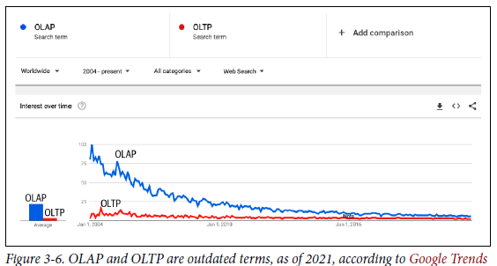
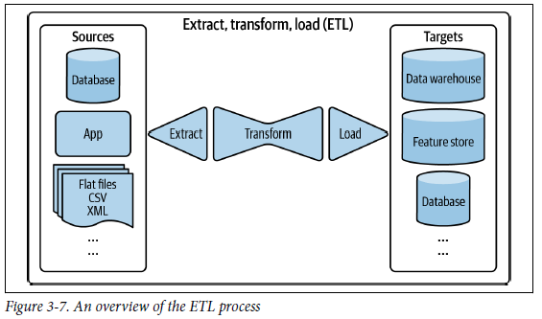
Storage and Processing Engines
OLTP: Rapid transaction processing.
OLAP: Complex queries on large volumes.
ETL: Data extraction, transformation, and loading.

Slide 9
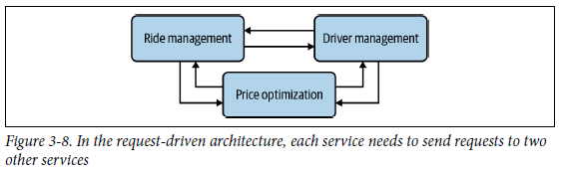
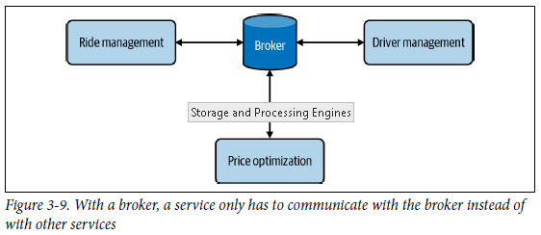
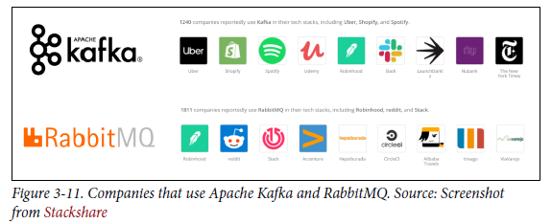
Data Flow Modes
Databases: Simple, but with latency.
Services: Direct communication, microservices architecture.
Real Time: Broker (Apache Kafka) for low latency.

Slide 10
Batch Processing vs. Stream Processing
Batch: For historical data, periodic processing.
Stream: Real-time data with Apache Flink.

Slide 11
Conclusion
Data fundamentals for ML in production.
Choosing the right formats and engines is essential.
Efficiency and flexibility for large volumes and velocity of data.

